Slide 1
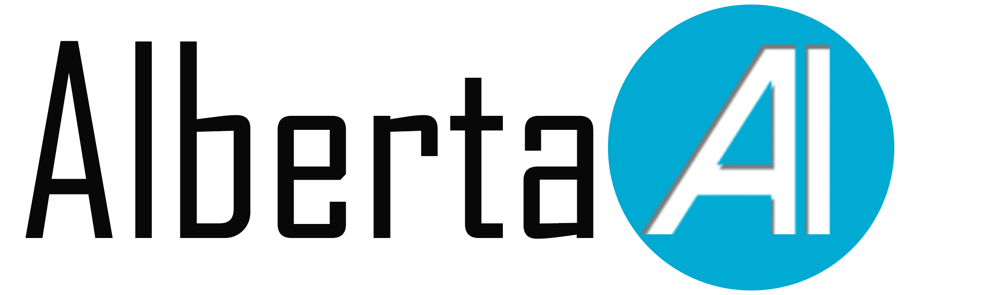
Introduction to Python and AI
Yongzhe Hong, MD, PhD
Data Analyst

Slide 2
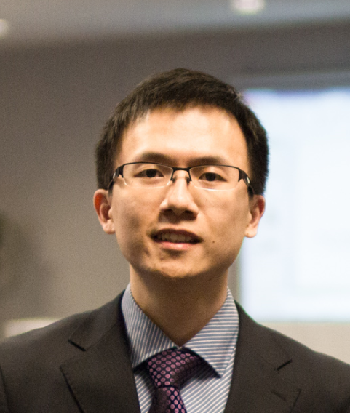
Instructor
Data analyst at Division of Cardiac Surgery at the University of Alberta
Member of the Biomedical AnaLytics Studio And Methods unit (BALSAM)
Co-founder of AlbertaAI
AlbertaAI mentor

Slide 3
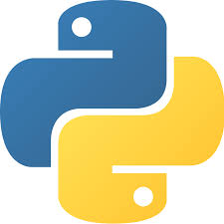
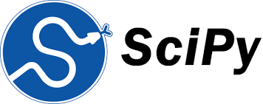
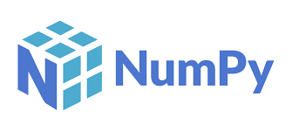
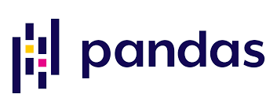
Outline
Running Python
Python syntax
Data types
Functions and help
Python list, tuple, dictionary and sets
Python loops
Python conditionals
Define Python functions
Python modules
Key modules: Numpy, Scipy, Pandas
Data visualization with Matplotlib and Seaborn
Introduction to Artificial Intelligence

Slide 4
8 Reasons why you should learn python

Slide 5
1. Perfect for rookies
Java
public class myfirstprogram {
C programming
Main()
Python
public static void main(String[] args)
{
System.out.println(“Hello World!");
}
}
{
Printf(“Hello World!\n”)
}
Print(“Hello world!)

Slide 6
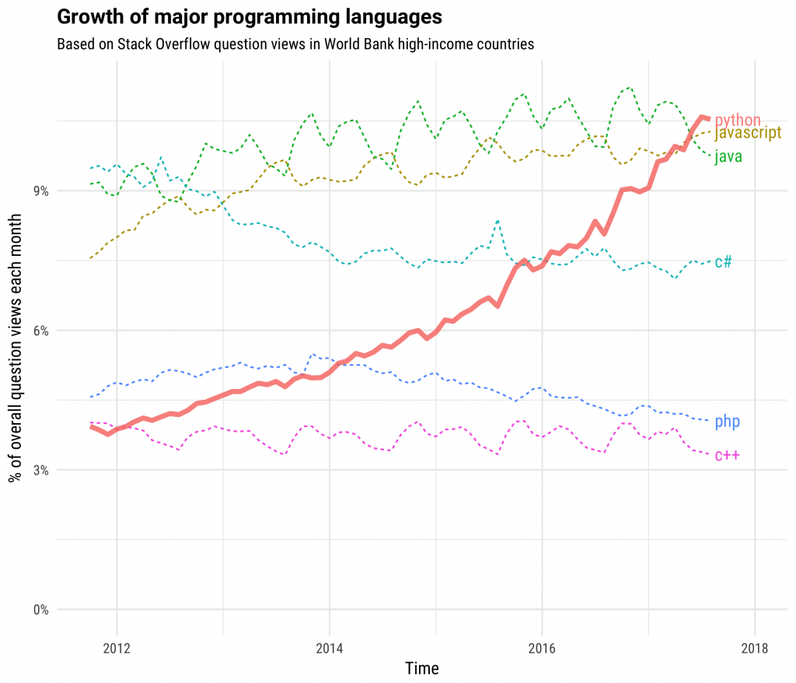
2. Large Community

Slide 7
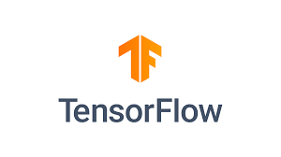
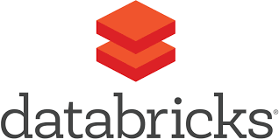
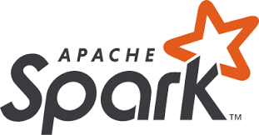
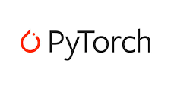
3. Popular for machine learning and AI

Slide 8

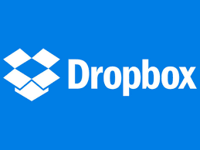


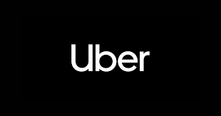

4. Web Development

Slide 9
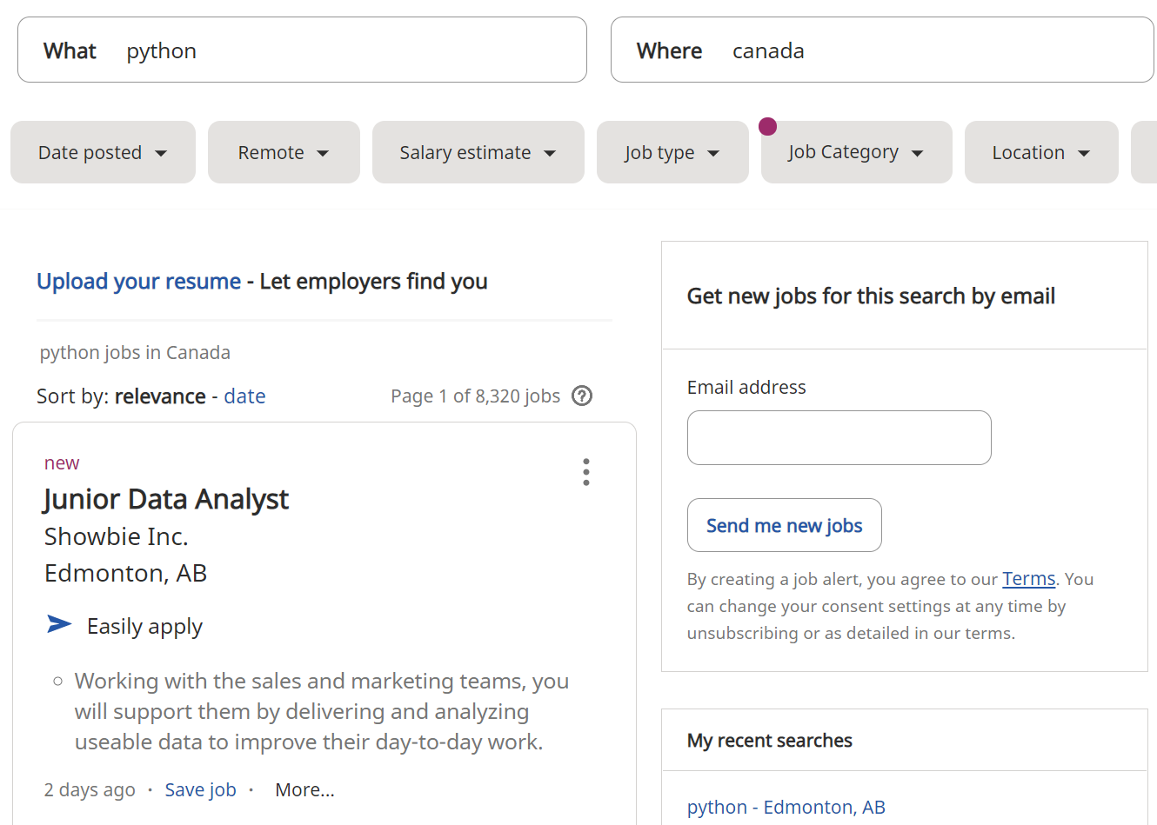
5. Career oppotunity

Slide 10
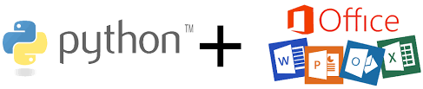
6. Office automation

Slide 11
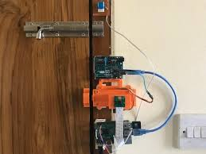
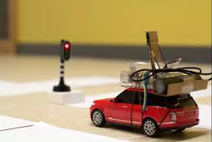
7. Internet Of Thing(IoT)
Smart Lock
Autonomous Car

Slide 12
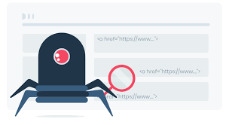
8. Web scrapping

Slide 13
Download the notebook
Website:
https://sites.google.com/view/python-and-ai

